Slide 1
ECE 178 – Discussion 7
Introduction to digital image processing
15th November 2024
Hardik Prajapati

Slide 2
Agenda
Quantization and Compression
Uniform quantization
Linear Predictive Coding (LPC)
LZ compression

Slide 3
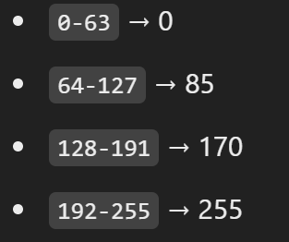
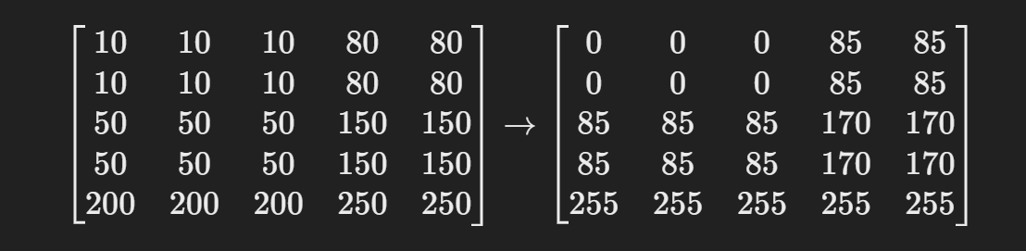
Uniform Quantization
process of mapping a range of input values to fewer output levels
to reduce data size
E.g. Grayscale Image quantization
Let’s say, I want to reduce 8-bit image to 2-bit image.
Using uniform quantization:
Saves space
Loss in visual details
Original Image
Quantized Image

Slide 4
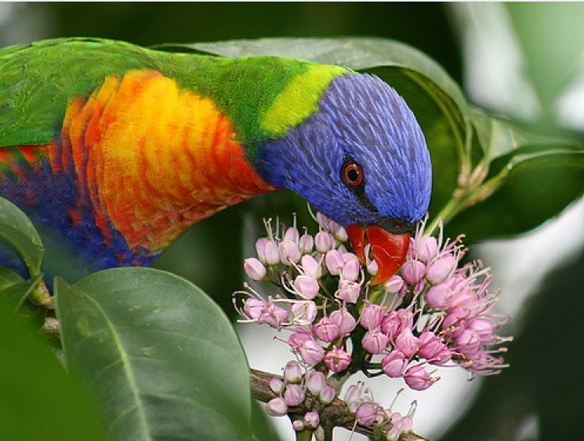

Original Image
Quantized Image
Minimum Brightness Variant Quadrant based Error Diffusion
(R,G,B)
Original image: 255*255*255 color tones
Quantized image: 8 color tones

Slide 5
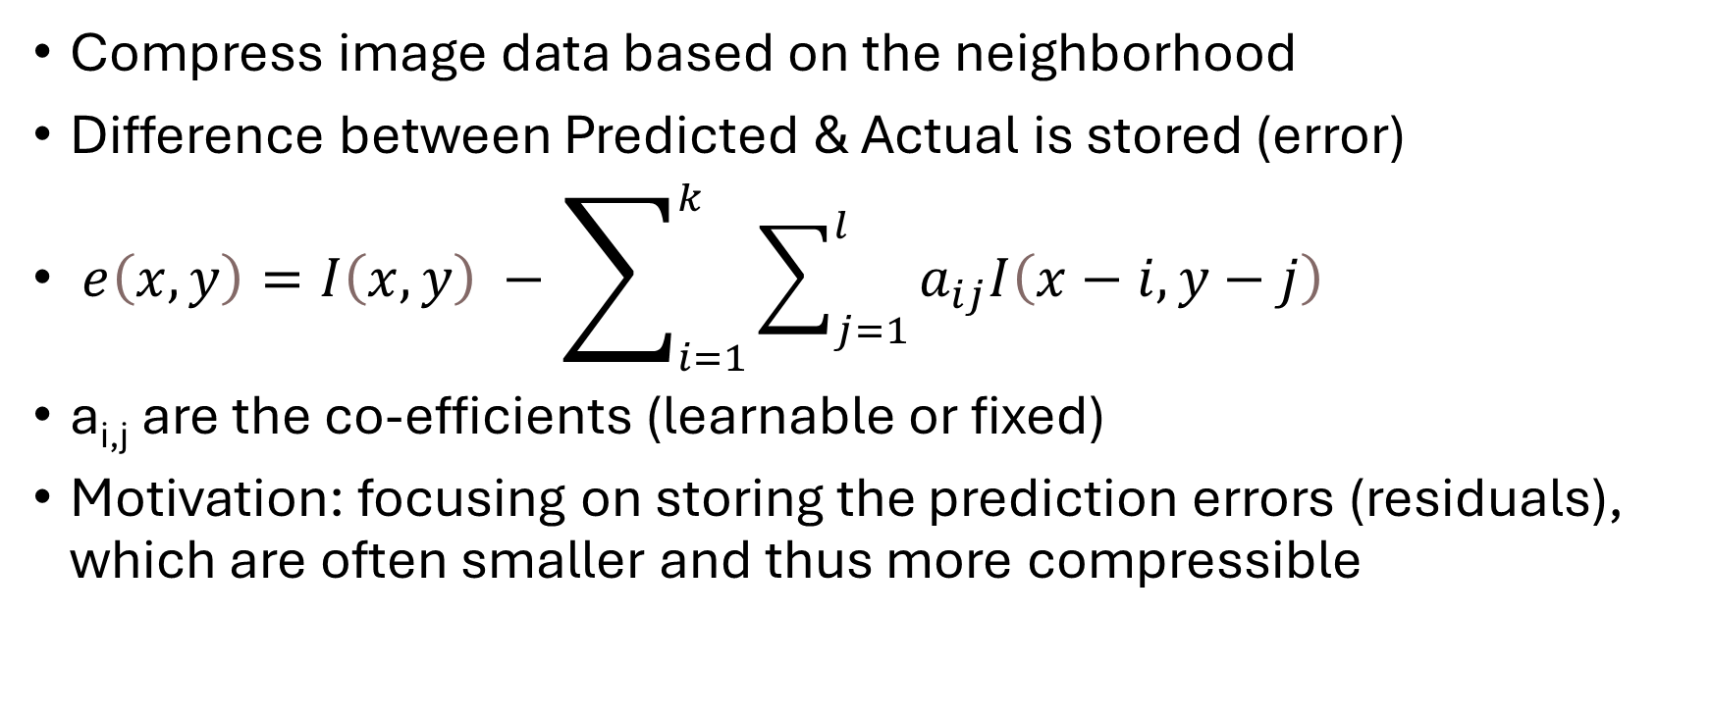
Linear Predictive Coding (LPC)
Compress image data based on the neighborhood
Difference between Predicted & Actual is stored (error)
$ⅇ\left(x,y\right)=I\left(x,y\right) −\sum_{i=1}^{k}{\sum_{j=1}^{l}{a_{ij}I\left(x−i,y−j\right)}}$
a_{i,j} are the co-efficients (learnable or fixed)
Motivation: focusing on storing the prediction errors (residuals), which are often smaller and thus more compressible

Slide 6
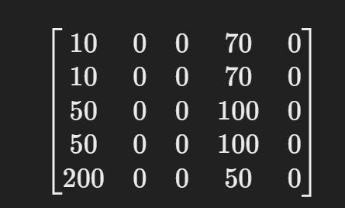
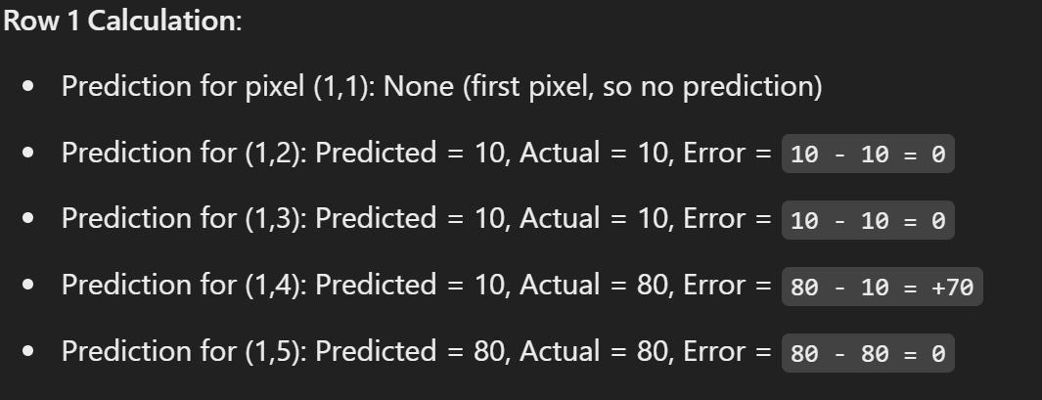
LPC (continued)
E.g. k =1 , l = 0, and a_{i,j}= 1 i.e. predict current pixel based on the previous pixel of same row
Original Image
Compressed Image
(Residual error matrix)

Slide 7
LZ compression (Lempel–Ziv)
Lossless data compression algorithm
works by identifying patterns in data and encoding them in a more compact form
E.g. "ABABABABAB“ → (AB)5 i.e. "repeat AB 5 times."

Slide 8
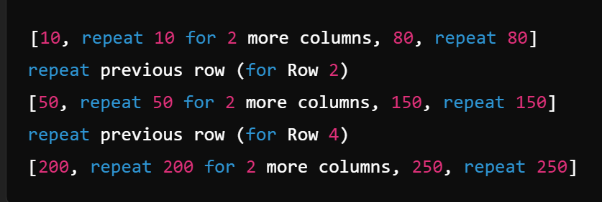
Row Patterns: Rows 1 and 2 are identical, as are rows 3 and 4.
Column Patterns: In each row, columns 1-3 have identical values.
Compression Steps:
Row Encoding:
Instead of storing each pixel in rows 1 and 2 separately, we can store row 1 and represent row 2 as "repeat row 1". Similarly, store row 3, and represent row 4 as "repeat row 3".
Column Encoding:
Within each row, rather than storing each value in columns 1–3, encode it as “repeat [value] for 3 columns.”
Original Image
Reduced number of stored values
Compressed version

